Slide 1
Lobbying the EU - strategy options
© NICK HALL
Andras Krolopp, TNC Senior Policy Adviser, Mai 2016

Slide 2
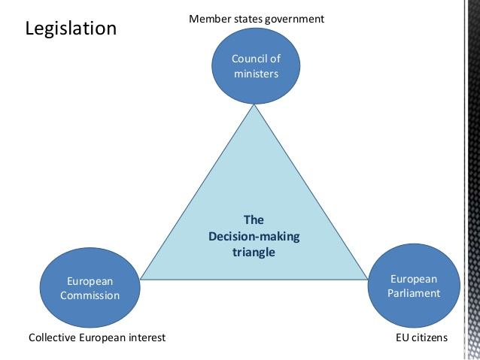
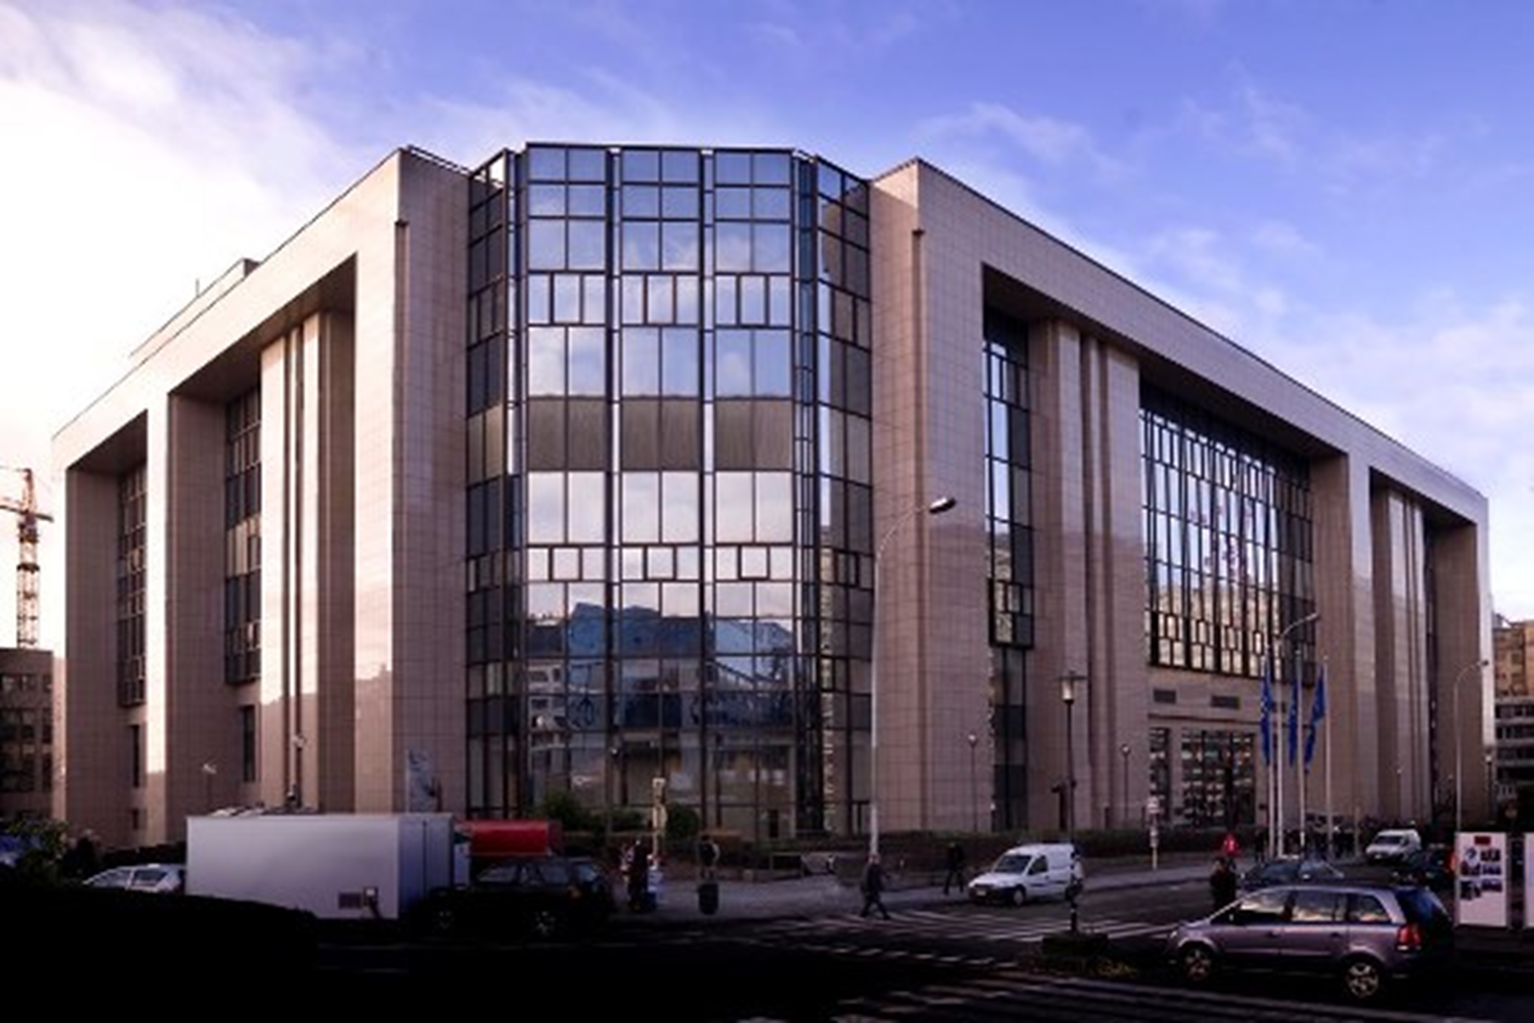
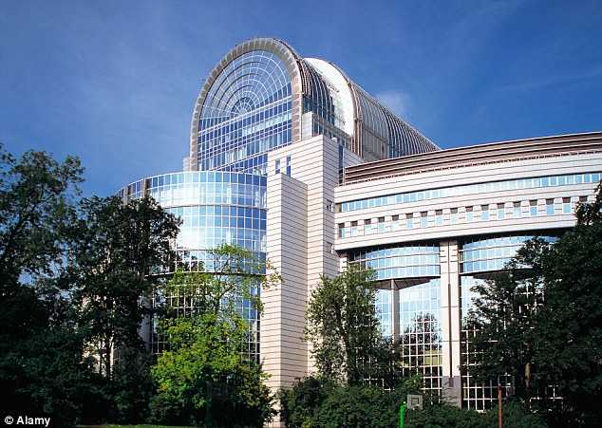
Structure of the EU – the decision making „Holy Trinity“
TNC
TNC

Slide 3
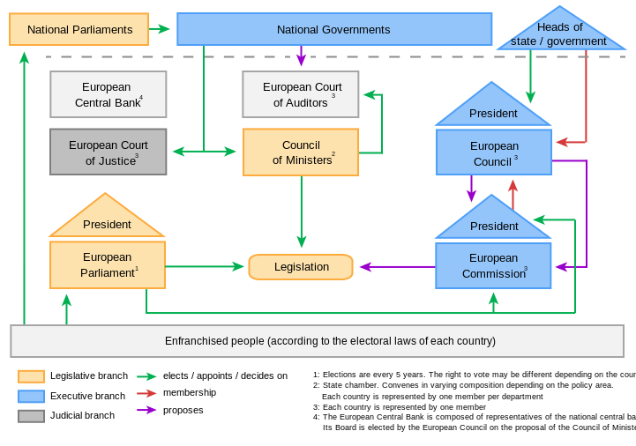
Structure of the EU – the decision making „holy trinity“

Slide 4
„Where are the needles on policy?“
Member States
Decisions “Council Conclusion”
EU Council
Policies strategies
Financial Commitment
Financial flows (projects)
EU Council
Member States
NGOs
NGOs
TNC
European Parliament
Member States
NGOs
NGOs

